Slide 1

Heart Disease Prediction Using Hybrid Models
MCR4
Progress Update

Slide 2
Advancements in ML Hybrid Techniques
These machine learning techniques below are used to improve model performance:
Bagging: Combines predictions from multiple models trained on different data samples to reduce variance and improve accuracy.
Boosting: Builds models sequentially, where each model tries to correct the errors of the previous one to improve performance.
Grid Search: Finds the best hyperparameters by trying all possible combinations in a defined range.

Slide 3
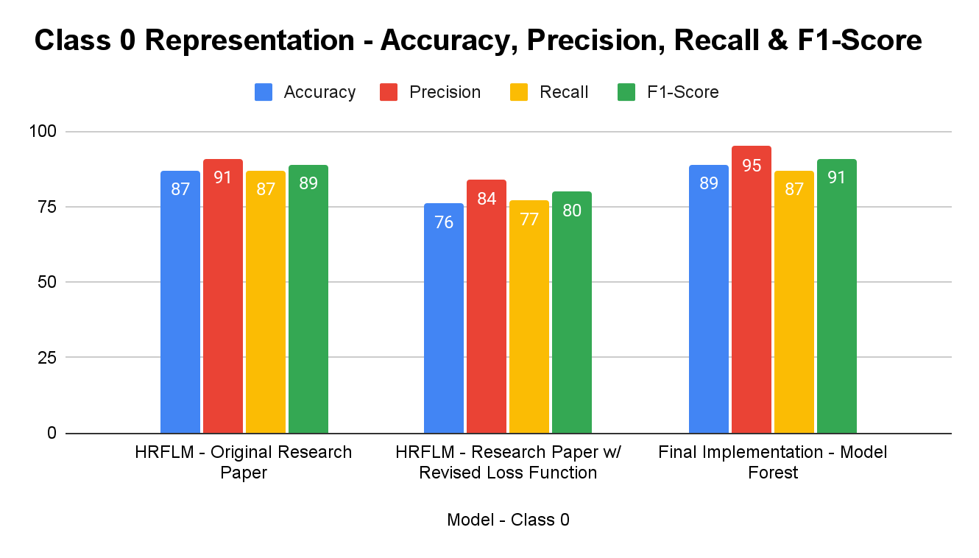
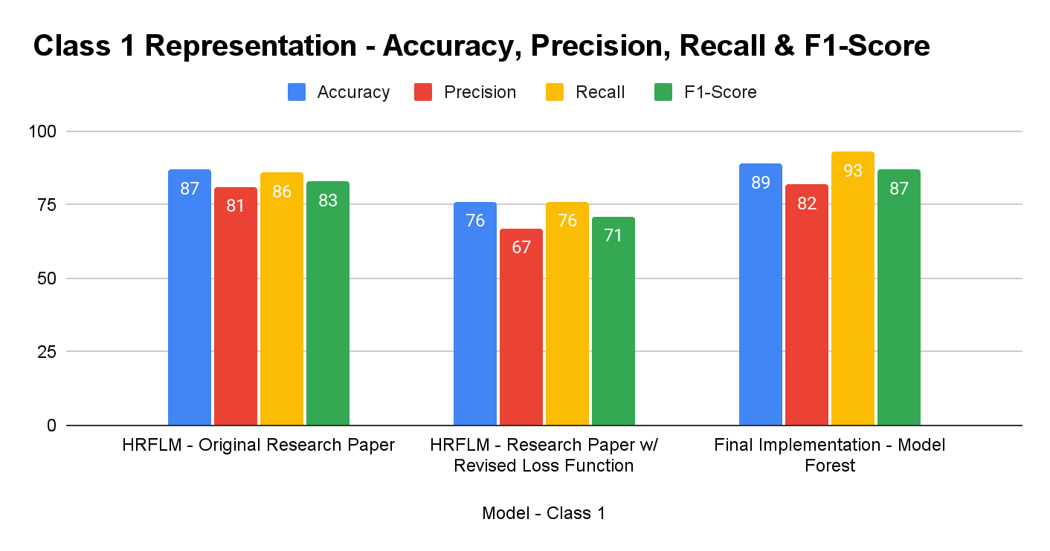
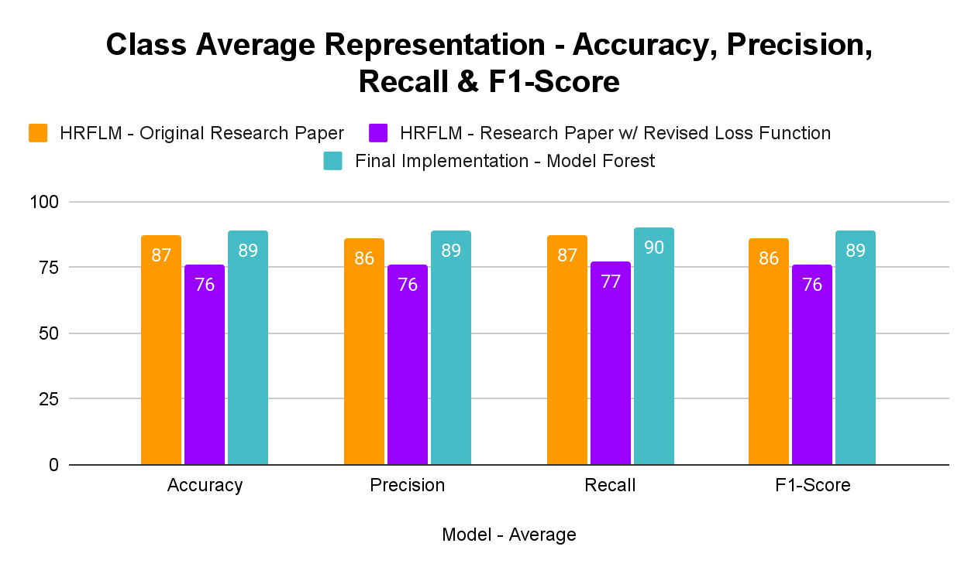
Model Switching and Results
HRFLM Implementation vs. ModelForest Implementation

Slide 4
Tabular Results
Model - Class 0 | Accuracy | Precision | Recall | F1-Score
HRFLM - Original Research Paper | 87 | 91 | 87 | 89
HRFLM - Research Paper w/ Revised Loss Function | 76 | 84 | 77 | 80
Final Implementation - Model Forest | 89 | 95 | 87 | 91
Model - Class 1 | Accuracy | Precision | Recall | F1-Score
HRFLM - Original Research Paper | 87 | 81 | 86 | 83
HRFLM - Research Paper w/ Revised Loss Function | 76 | 67 | 76 | 71
Final Implementation - Model Forest | 89 | 82 | 93 | 87
Model - Average | Accuracy | Precision | Recall | F1-Score
HRFLM - Original Research Paper | 87 | 86 | 87 | 86
HRFLM - Research Paper w/ Revised Loss Function | 76 | 76 | 77 | 76
Final Implementation - Model Forest | 89 | 89 | 90 | 89

Slide 5
User-Interface Implementation
Used Python and HTML to host a User Interface
Made sure the model works correctly and is able to give the right output each time stating weather Heart Disease was detected or not.
Is able to store the values and the output in a different excel file to later look at the values and feature inputs.

Slide 6


